Slide 1

Skin Disease Detection using Convolution Neural Network
CS5720 Neural Networks & Deep Learning - Project (CRN: 13994)

Slide 2
Group Members:
1. Bharath Karingula (700745611)
2. Dileep kumar Podeti (700747021)
3. Tharun Tej Rathod (700756008)

Slide 3
Motivation:
The primary motivation behind the research project titled "Derm-NN: Skin Diseases Detection Using Convolutional Neural Network" lies in addressing the global prevalence of skin diseases. Skin, being a vital protective barrier, is susceptible to various infections affecting millions of people worldwide. The motivation stems from the recognition of the severity of skin ailments, ranging from common issues like acne to more severe conditions with significant health implications. The authors aim to contribute to the field of medicine by developing a prototype—Derm-NN—that leverages Convolutional Neural Networks (CNNs) for the accurate detection of five specific skin diseases. The system's intent is to enable early disease identification, precise medication, and increased awareness. By combining image processing techniques and machine learning, the research strives to provide an automated and efficient solution for the detection and classification of skin diseases, thereby enhancing healthcare outcomes.

Slide 4
Problem Statement:
Skin is one of the most important organs in the human body. It acts as a shield to protect our internal body from getting damaged. But this important part of the human body can be affected by serious infections caused by some fungi or viruses or even dust too.
A proper diagnosis can reduce the miseries of the people and helps to create awareness. So, we have wanted to develop a prototype to detect skin diseases using neural networks. In the choice of neural networks, we have chosen CNN which abbreviates as a convolutional neural network.
Data Augmentation is done utilizing 5 unique techniques. 1. Rotate +90 degrees 2. Rotate -90 degrees 3. Shading 4. Adding salt and pepper noise 5. Flip Horizontal. In any case, our profound neural classifier needs a comparable informational index for training and testing the informational index. So we set the pixels to 100 X
100. At that point, we changed over to the picture grayscale to prepare our model. Our idea is to build up a new CNN model, In our model, we have 13 layers. We also have 4 convolutional layers. This CNN model is trained with 1920 images and testing is performed on 480 images.

Slide 5
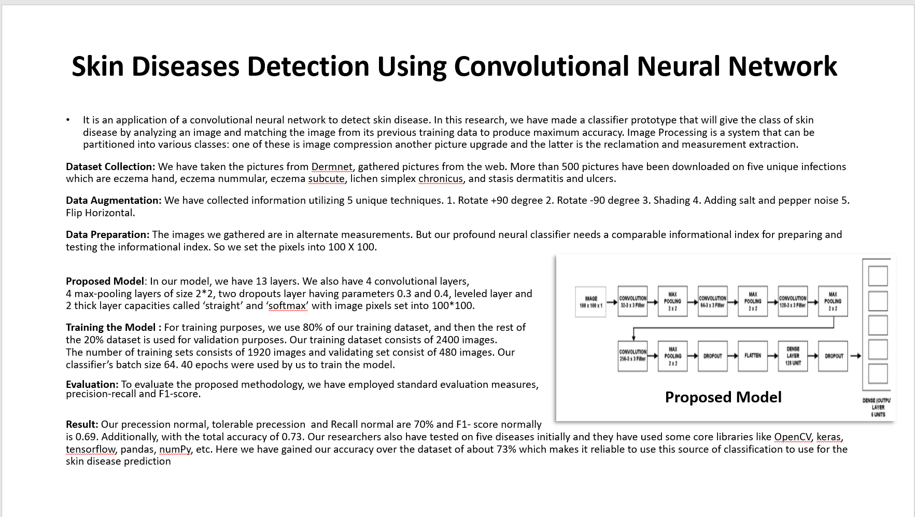

Slide 6
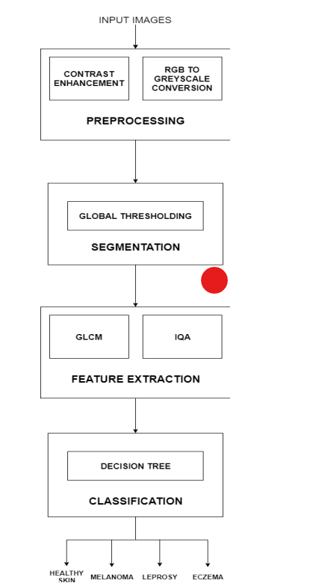
Skin Disease Detection And Classification
Skin diseases are primarily diagnosed visually, beginning with an initial clinical screening and followed potentially by dermoscopic analysis. The dermatologist then performs visual analysis using various tests, some of which include patch test, Biopsy, Culture etc. which may prone to human errors.
The system takes as input an image of the affected skin region and feeds it to the pre-processing techniques.
Image pre-processing: Image pre-processing consists of two sub-processes, Contrast Enhancement, and Grayscale Conversion.
A raw binary image is converted into the RGB (red/green/blue) Matrix form. The RGB Matrix is first processed for Contrast
Enhancement and converted to a contrast-enhanced RGB Matrix, this is done so as to distinguish each pixel from its neighbour.
Contrast enhancement is performed using Histogram equalization. The contrast-enhanced RGB Matrix is converted into
Grayscale Matrix.
Segmentation: Global thresholding[7] partitions an image into objects and background. It is the simplest of all thresholding.
Segmentation is then achieved by scanning each pixel and labelling it as background or foreground depending on the grey
level of that pixel.
Feature Extraction: This feature extraction is the process where we will be representing a raw image in a reduced form to
help decision-making pattern detection or classifications. This process is widely used in machine learning. These are the
general terms of the methods where we can construct combinations of the variable to get along with these problems while
we can describe the data with high accuracy. Hence, we have divided this process into two methods for better feature
extraction GLCM (Grey Level Co-occurrence Matrix) and Image Quality Assessment.
Classification: Decision trees use a tree-like structure in which decisions and their possible outcomes are represented.
A decision tree has a root node which is divided further into child nodes. A decision tree has three types of nodes: chance
nodes, decision nodes, and end nodes. A chance node, denoted by a circle, represents the probabilities of certain results.
A decision node, represented by a square, shows a decision to be made, and an end node shows the final outcome of a decision path.
RESULTS: The system proposed is a Skin Disease Detection System. This system uses images of skin captured with a camera
to detect if it is healthy or not; if not, then classified as Melanoma, Eczema or Leprosy.

Slide 7
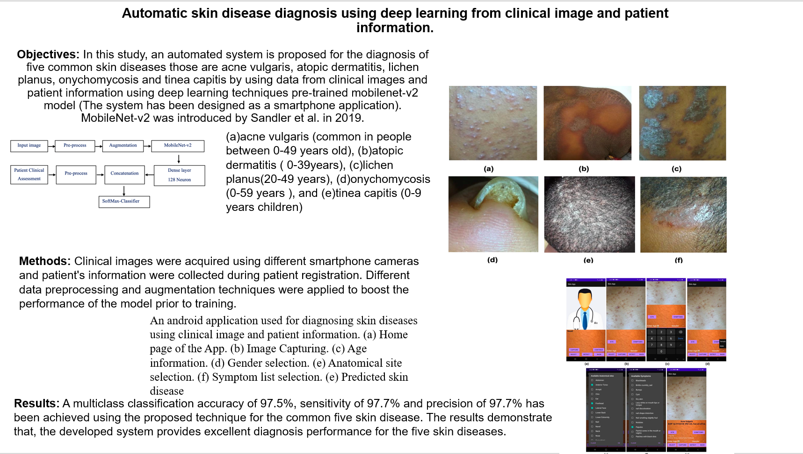

Slide 8
Skin disease detection using deep learning.
Abstract:
This work provides an automated image-based method for diagnosing and categorizing skin problems using machine learning. Such a technique is essential to diagnose skin diseases without limitations.
Computational techniques will be used to analyze, process and sort through the many different characteristics of incoming photos.
Skin photographs are first processed to remove noise and then enhanced through convolutional neural networks. This process can extract features from an image and classify the picture using a classifier’s algorithm. An output diagnostic report is provided as an output.
The proposed system will be more efficient and reliable than the current methods for diagnosing dermatological illnesses.
Introduction:
Dermatologic diseases are the most predominant kind of disease globally, yet they are challenging to diagnose. Early identification is crucial for improved outcomes. The prevalence of skin diseases is increasing and early detection is crucial. However, the devices necessary for this early detection are still not generally available to most people. The proposed study establishes a mechanism for recognizing various forms of these illnesses and also diagnoses using softmax classification.If no illness is detected, the system responds negatively to the user.
Our proposed solution relies on a straightforward, quick image processing methodology and techniques. This procedure starts with a digital photo of the sick skin region, then analyzed to determine the kind of illness discovered.
Methodology:
The following techniques will be explained in this chapter. They are designed to help you identify skin disorders that do not require medical care by providing colour images, which we can process using clustering and other colour gradient algorithms.
The first and most important step in this research was to compile a set of photographs of skin diseases. This dataset, which includes six prevalent skin diseases, will be made public after all necessary processes have been completed.
All images are acquired using digital cameras and accompanied by pathology results. The number of features in each image depends on the size of the picture, which can be reduced to a single measure. Shrinking the picture decreases processing time and improves overall performance.
Conclusion:
The proposed method is more accurate than the existing methods for extracting features from skin images and classifying them using a Softmax classifier. The accuracy of 0.87 suggests that this method is highly efficient in detecting and diagnosing skin problems. This work can be helpful for students or researchers in the medical field.

Slide 9
Evaluating Result:
First, an image of the contaminated region of their skin is taken. The pictures of illness will be handled by the model and it will classify the skin disease if it matches one of the five skin diseases on which it was trained. Our evaluation metrics will be accuracy, f1 score, recall, and precision. As this is the classification task we will consider the confusion matrix for the model used in the implementation.

Slide 10
References:
[1]. Goceri, E. (2019). Skin disease diagnosis from photographs using deep learning. In VipIMAGE 2019: Proceedings of the VII ECCOMAS Thematic Conference on Computational Vision and Medical Image Processing, October 16–18, 2019, Porto, Portugal (pp. 239-246). Springer International Publishing.
[2]. Li, H., Pan, Y., Zhao, J., & Zhang, L. (2021). Skin disease diagnosis with deep learning: a review. Neurocomputing, 464, 364-393.
[3]. Inthiyaz, S., Altahan, B. R., Ahammad, S. H., Rajesh, V., Kalangi, R. R., Smirani, L. K., ... & Rashed, A. N. Z. (2023). Skin disease detection using deep learning. Advances in Engineering Software, 175, 103361.
[4]. Li, L. F., Wang, X., Hu, W. J., Xiong, N. N., Du, Y. X., & Li, B. S. (2020).
Deep learning in skin disease image recognition: A review. IEEE Access, 8, 208264-208280.
[5]. Kumar, V. B., Kumar, S. S., & Saboo, V. (2016, September). Dermatological disease detection using image processing and machine learning. In 2016 Third
International Conference on Artificial Intelligence and Pattern Recognition (AIPR)
(pp. 1-6). IEEE.
[6]. Anand, V., Gupta, S., & Koundal, D. (2022). Skin disease diagnosis: challenges and opportunities. In Proceedings of Second Doctoral Symposium on Computational Intelligence: DoSCI 2021 (pp. 449-459). Springer Singapore.
[7]. Rathod, J., Waghmode, V., Sodha, A., & Bhavathankar, P. (2018, March). Diagnosis of skin diseases using Convolutional Neural Networks. In 2018 second international conference on electronics, communication and aerospace technology (ICECA) (pp. 1048-1051). IEEE.
[8]. Rimi, T. A., Sultana, N., & Foysal, M. F. A. (2020, May). Derm-NN: skin diseases detection using convolutional neural network. In 2020 4th International Conference on Intelligent Computing and Control Systems (ICICCS) (pp. 1205-1209). IEEE.

